Slide 1
Chapter 2 Transmission Fundamentals
Dr.Mohammed Abdalla Youssif
1

Slide 2
Electromagnetic Signal
2
Function of time
Can also be expressed as a function of frequency
Signal consists of components of different frequencies.
Notes:
Wireless Communications and networks – William Stallings
2

Slide 3

Time-Domain Concepts
3
Analog signal: signal intensity varies in a smooth fashion over time
No breaks or discontinuities
Digital signal: signal intensity maintains a constant level for some period of time and then changes to another constant level.
Periodic Signal: analog or digital signal pattern that repeats over the time.
Notes:
3

Slide 4
Time-Domain Concepts
4
Aperiodic Signal: analog or digital signal pattern that does not repeat over the time
Peak amplitude (A): a maximum value or strength of the signal over time, typically measured in volts.
Frequency(F): Rate, in cycles per second, or Hertz(Hz) at which the signal repeats.
Notes:
4

Slide 5
Time-Domain Concepts
5
Period (T): amount of time it takes for one repetition of the signal T=1/F
Phase() - ) –measure of the relative position in time within a single period of a signal.
Wavelength( ) – distance occupied by a single cycle of the signal.
Or, the distance between two points of corresponding phase of two consecutive cycles.
Notes:
5

Slide 6
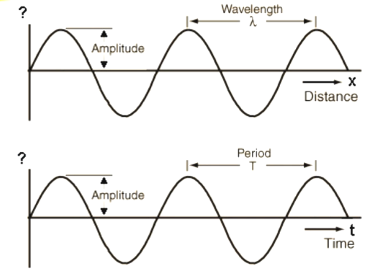
Periodic Signal Example
6
Notes:
6

Slide 7
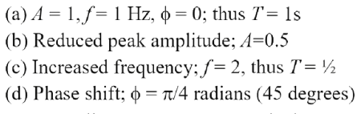
Sine Wave Parameters
7
General Sine Wave
The next figure shows the effect of varying each of the three parameters (amplitude, frequency, phase):
Note:
Notes:
7

Slide 8
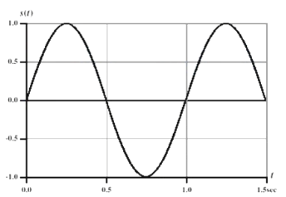

Case 1
8
Parameters: Amplitude =1, Frequency=1, phase=0
Notes:
8

Slide 9
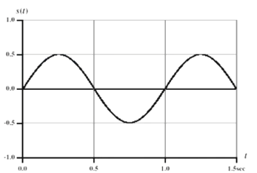
Case 2
9
Parameters: Amplitude =0.5, Frequency=1, phase=0
Notes:
9

Slide 10
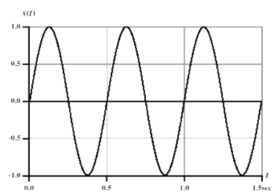
Case 3
10
Parameters: Amplitude =1, Frequency=2, phase=0
Notes:
10

Slide 11
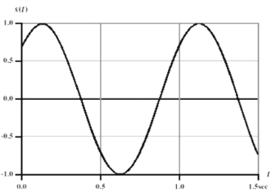
Case 4
11
Parameters: Amplitude =1, Frequency=2, phase=0
Notes:
11

Slide 12
Time VS. Distance
12
When the horizontal axis is time, as shown in the pervious figure, the graph displays the value of a signal at a given point in space as a function of time.
With horizontal axis in space, graph displays the value of a signal at a given point in time as function of distance
At a particular instant of time, the intensity of the signal varies as a function of distance from the source.
Notes:
12

Slide 13
Frequency-Domain Concepts
13
Fundamental frequency – when all frequency components of a signal are integer multiples of one frequency, it’s refereed to as the fundamental frequency
Spectrum – range of frequencies that a signal contains
Absolute bandwidth- width of the spectrum of signal
Effective bandwidth (or just bandwidth) – narrow band of frequencies that most of signal’s energy is contained in.
Notes:
13

Slide 14
Frequency-Domain Concepts
14
Any electromagnetic signal can be shown to consists of a collection of periodic analog signals (sine waves) at different amplitudes, frequencies, and phases
The period of the total signal is equal to the period of the fundamental frequency.
Notes:
14

Slide 15
Data Communication Terms
15
Data – entities that convey meaning, or information
Signals – electric or electromagnetic representations of data., Signals can be analog or digital.
Examples of analog data: video and audio
Examples of digital data : text
Transmission – communication of data by the propagation and processing of signals
Notes:
convey نقل
15

Slide 16
Analog signals
16
A continuously varying electromagnetic wave that may be propagated over a variety of media, depending on the frequency.
Analog signals can propagate analog and digital data
Notes:
convey نقل
16

Slide 17
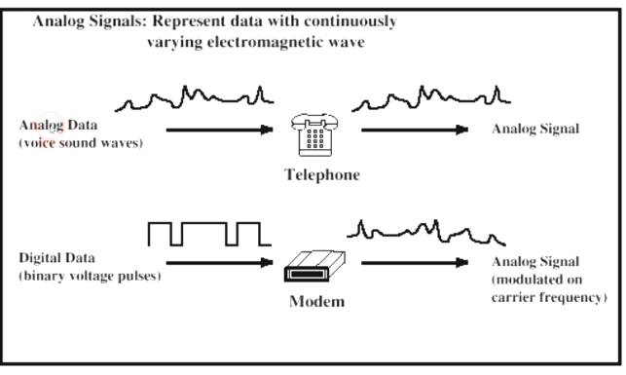
Analog signals
17
Notes:
convey نقل
17

Slide 18
Digital signals
18
A sequence of voltage pulses that may be transmitted over a copper wire medium
Generally cheaper than analog signaling
Less susceptible to noise interference
Suffer more from attenuation
Digital signals can propagate analog and digital data.
Notes:
convey نقل
18

Slide 19
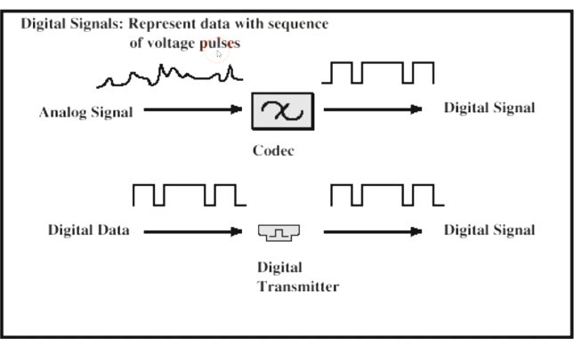
Digital signals
19
Notes:
convey نقل
19

Slide 20
Reasons for Choosing Data and Signal Combinations
Digital data, digital signal
Equipment for encoding is less expensive than digital-to-analog equipment
Analog data, digital signal
Conversion permits use of modern digital transmission and switching equipment
Digital data, analog signal
Some transmission media will only propagate analog signals
Examples include optical fiber and satellite
Analog data, analog signal
Analog data easily converted to analog signal
20
Notes:
convey نقل
20

Slide 21
Analog Transmission
Transmit analog signals without regard to content
Attenuation limits length of transmission link
Cascade amplifiers boost signal’s energy for longer distances but cause distortion
Analog data can tolerate distortion
Introduces errors in digital data.
21
Notes:
convey نقل
21

Slide 22
Digital Transmission
Concerned with the content of the signal
Attenuation endangers integrity of data
Digital Signal
Repeaters achieve greater distance
Repeaters recover the signal and retransmit
Analog signal carrying digital data
Retransmission device recovers the digital data from analog signal
Generate new, clean analog signal.
22
Notes:
convey نقل
22

Slide 23
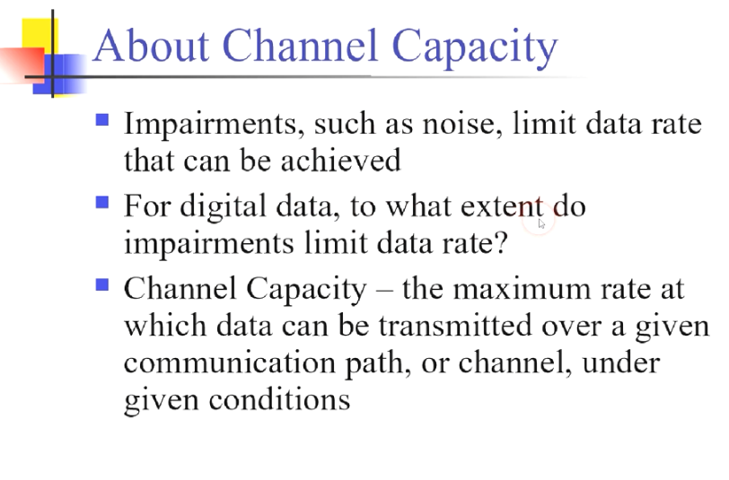
23
Notes:
convey نقل
23

Slide 24
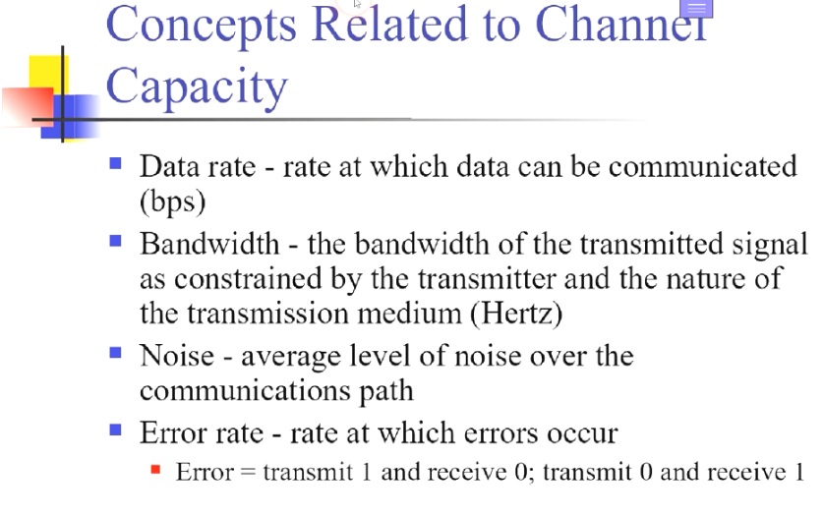
24
Notes:
convey نقل
24

Slide 25
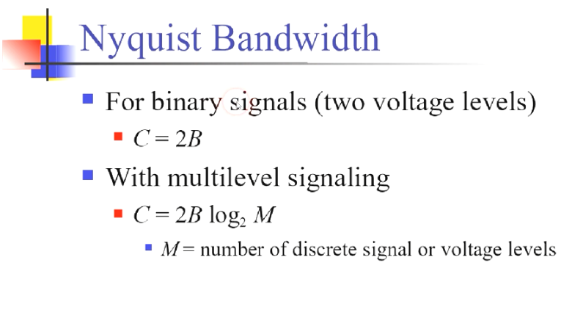
25
Notes:
25

Slide 26
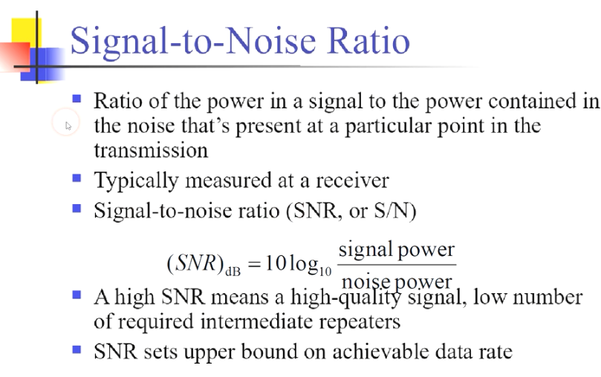
26
Notes:
26

Slide 27
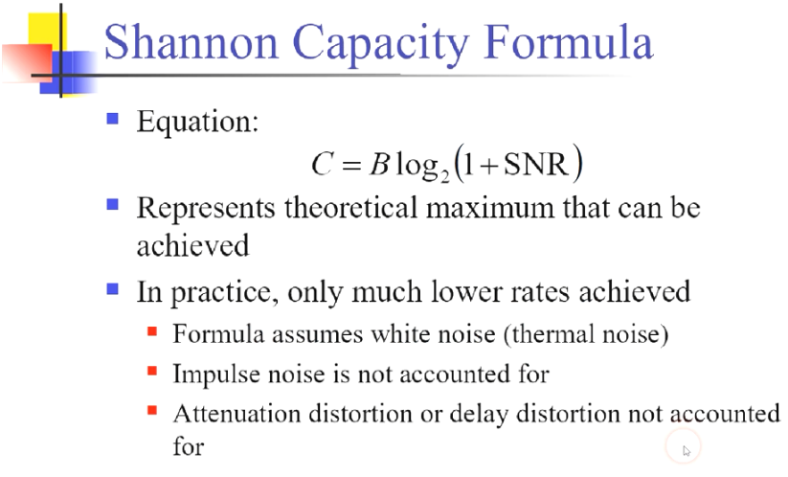
27
Notes:
27

Slide 28
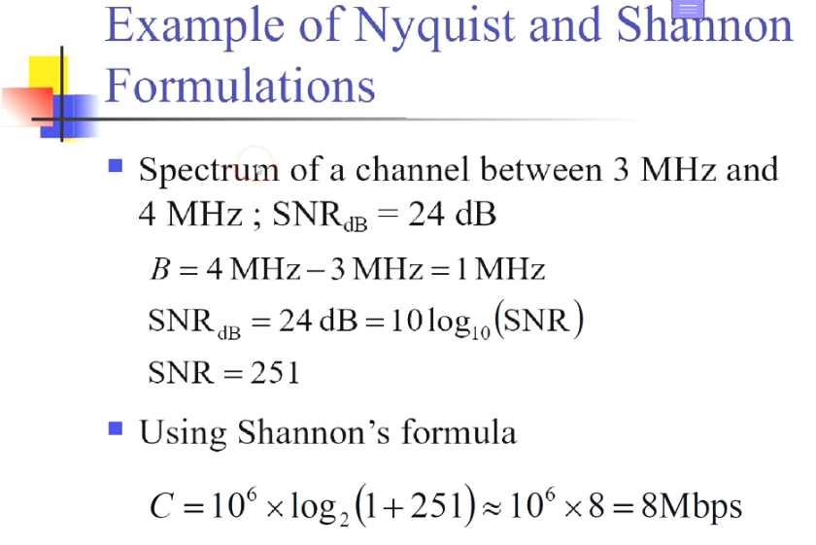
28
Notes:
28

Slide 29
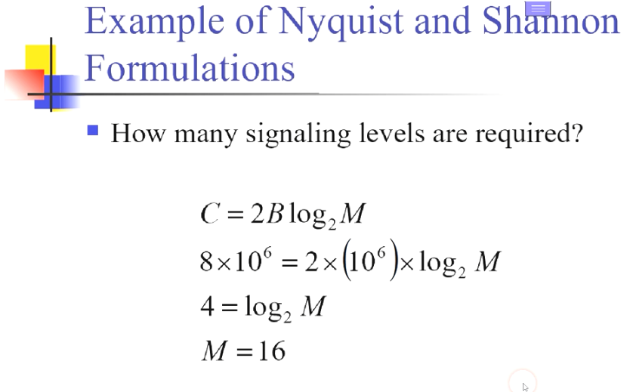
29
Notes:
29

Slide 30
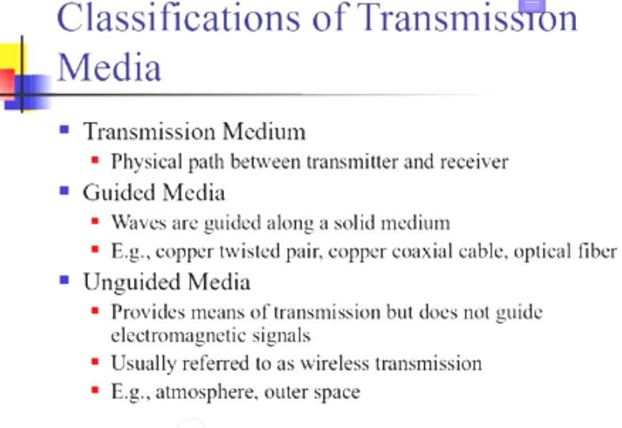
30
Notes:
30

Slide 31
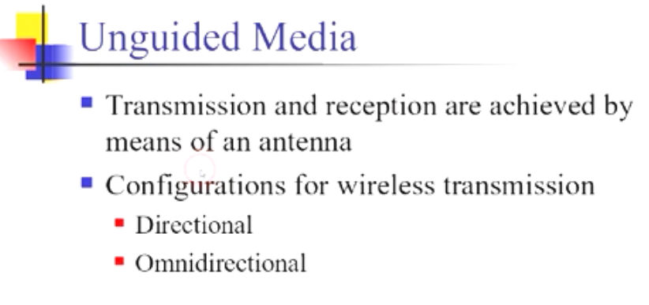
31
Notes:
31

Slide 32
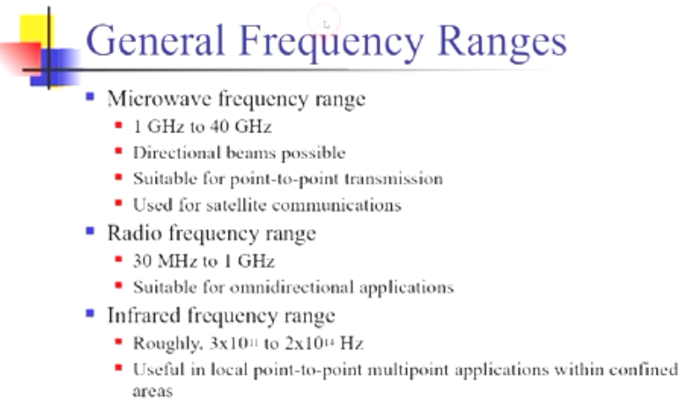
32
Notes:
32

Slide 33
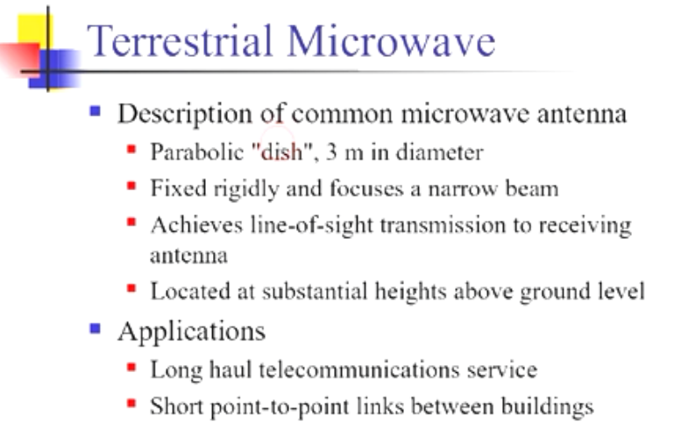
33
Notes:
33

Slide 34
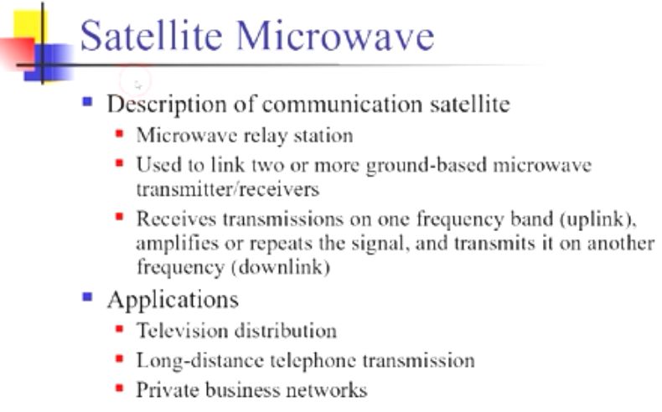
34
Notes:
34

Slide 35
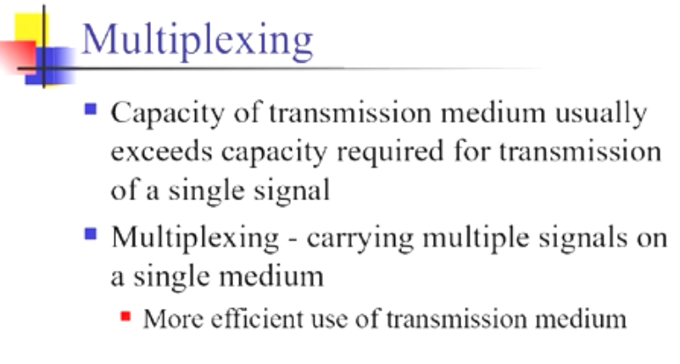
35
Notes:
35

Slide 36
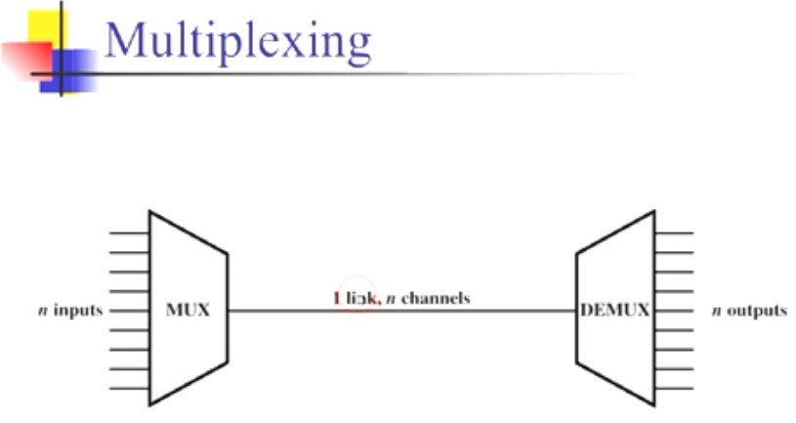
36
Notes:
36

Slide 37
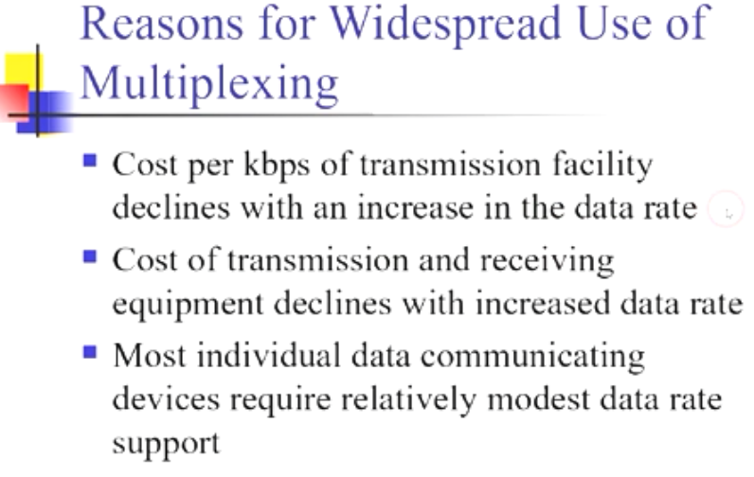
37
Notes:
37

Slide 38
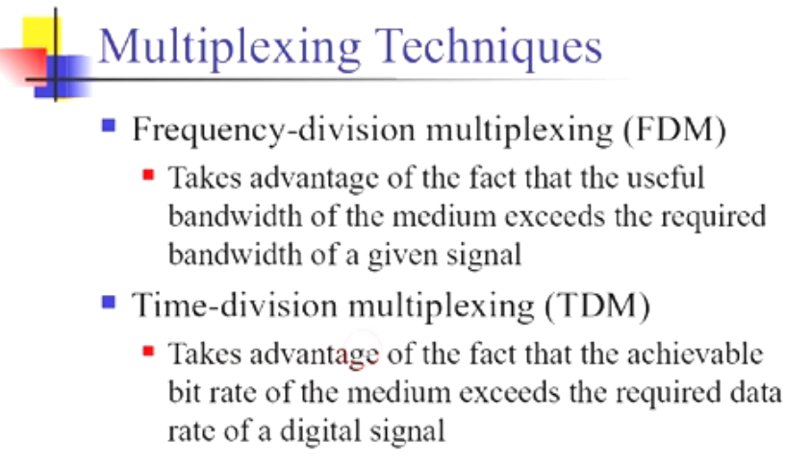
38
Notes:
38

Slide 39
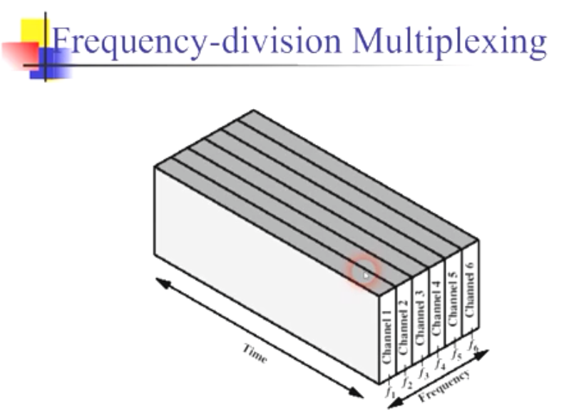
39
Notes:
39

Slide 40
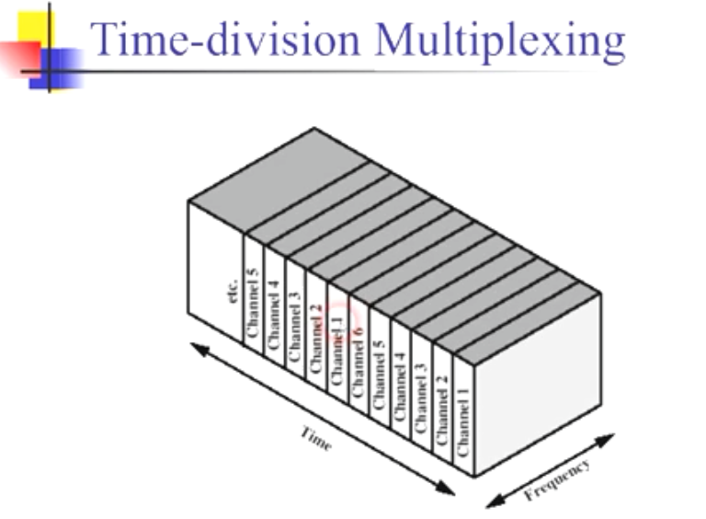
40
Notes:
40

Slide 41
Questions ?
41
Notes:
41

